Slide 1
Youth Sports Tournaments
  Capstone Exam MEM
  Todd Easton, Ph.D.

Slide 2
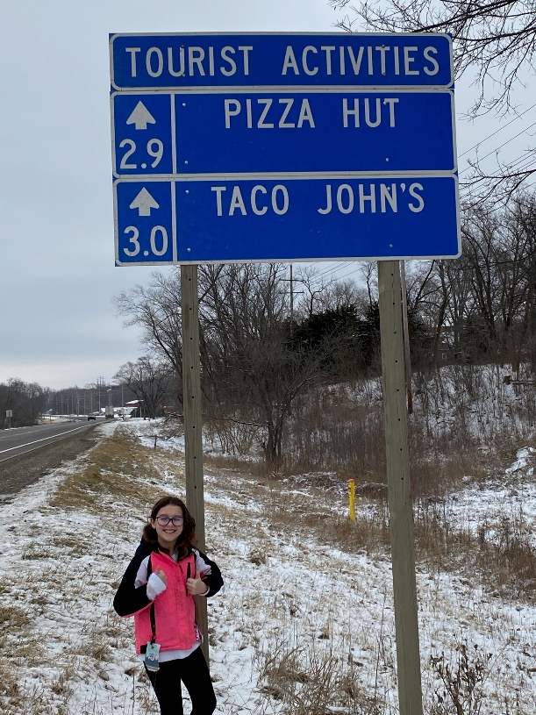
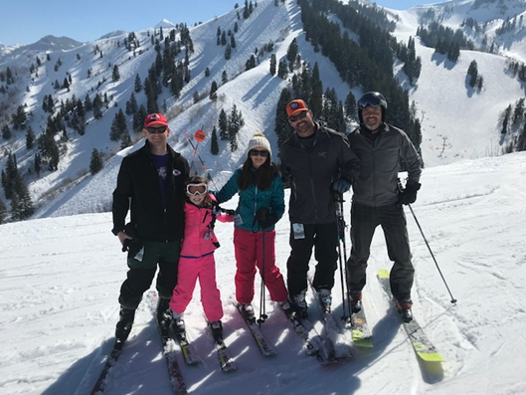
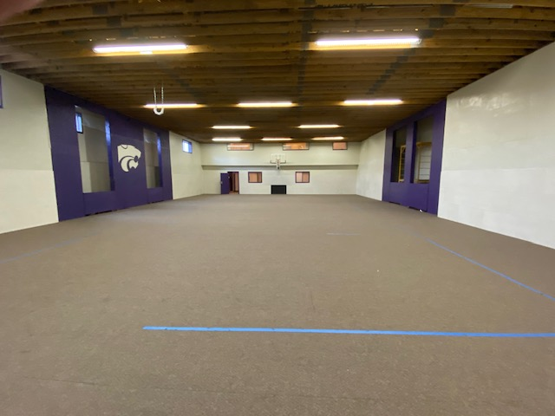
Todd Easton
B.S. BYU Math, MSOR Stanford, Ph.D ISYE Georgia Tech
Associate Professor and University Distinguished Teaching Scholar, Industrial and Manufacturing Systems Engineering, Kansas State University
2021- Professor (Lecturer) ME U of U
Wife and four kids
Enjoy the outdoors, sports, home improvement

Slide 3
I coached for a local soccer club.
I was in charge of the semiannual tournament.
It brought in thousands of dollars that helped defer the costs of the players and allow teams to travel to more prestigious tournaments.
The problem is to create a better tournament experience in the hopes of more teams and more money?

Slide 4
Program of Study (30 hours)
SIME 6500 Management and Leadership for Engineers
SIME 6530 Project Management for Engineers
SIME 6560 Engineering Economic Analysis
SIME 6400 Fundamentals of Systems Engineering
ME EN 6183 Discrete Event Systems Simulation
ME EN 6170 System Engineering and Integration
SIME 6050 Operations Research for Systems
SIME 6000 Analytics for Systems Management
SIME 6450 Design of Production and Service Systems
ME EN 6100 Ergonomics

Slide 5
SIME 6530
Hosting a tournament is a big project.
PERT/CPM for the major tasks, which include field rentals, advertising, check in, scheduling, referees, etc.
Trouble shooting- Kids sports is chaos and the dumbest things occur. You are dealing with volunteers. Some key person is probably going to get in a battle with their child’s coach and quit.
On-time time is most important. Then scope and finally cost.

Slide 6
SIME 6050
Create an integer program to assign fields, times and game.
    Sets: Teams (sorted by divisions)
        U11 and U 12 play on the same fields, but are in different divisions, etc.
    Fields: the fields available
    Times: The times for games. These are probably listed as slots with slot 1, slot 2, etc.
    Decision Variables: x_{ijft} = 1 if team i plays team j on field f at time t. 0 else

Slide 7

SIME 6050 Continued
  Each team has to play the correct number of pool games (assume 3 )
      $$\sum_{j in teams, f in fields, t in times}{x_{ijft}=3 for all i}$$
    If team i plays j, then j also plays i
        $$x_{ijft}=x_{jift} for all i, j, f and t$$
    At most one game on a field at a time.
    $$\sum_{j in teams, i in teams}{x_{ijft}≤2 for all f and t}$$
    Other constraints, including coaching constraints, preferred playing times, $x_{iift}$=0, etc.
    Objective is to minimize the number of times that a team plays another team with unequal daily rest

Slide 8
SIME 6560
An internet hotel managing group contacted me about providing “sponsor hotels.” The cost is $2,000 for such a service
The club would get 10% of the teams hotel stays.
Build a financial model to predict the benefit of entering into this agreement.

Slide 9
SIME 6560 Continued
Use past data to estimate how many teams are travelling and whether they will need hotel rooms.
Estimate how many hotel rooms will be taken and the general benefit.
Build a financial model to predict the benefit of entering into this agreement. Find the expected present worth of entering into this deal.
There is not really a time value of money calculation. So no need for IRR, ERR, PW, etc. Calculate the financial benefit to the club.

Slide 10
Ethical Considerations
Should the event be moved to a stay to play event (You have to register for at least 3 hotel rooms to be able to enter the tournament.)
Will this force poor teams to not enter?
Should access to quality sporting events be predicated upon wealth?
From a personal side, I was an unpaid coach, and my goal was to help youth play sports. (I chose not to do the stay to play. Some teams complained that it was difficult to find rooms).

Slide 11
Additional Considerations
Youth sports create many conflicts, but in my opinion, provide a substantial benefit to public health and welfare
Sports, like math, transcends languages and cultures. It should be a fair place to engage and helps with global, cultural and social factors.

Slide 12
Other classes I could have used
Note: This slide is not in a typical Capstone Exam, but is provided here just to help students prepare
SIME 6000 Perform analytics on my players, who was on the field for quality shot attempts by both teams.
SIME 6500 Leading the volunteers and setting policies to have enough volunteers
SIME 6400 Determining the needs and requirements of the stakeholders so that I actually improve the tournament experience and not just my opinion of the tournament.

Slide 13
Questions

